Slide 1

Brought to you by Group 6 - TroyCS2
Sorting Algorithms in C++

Slide 2
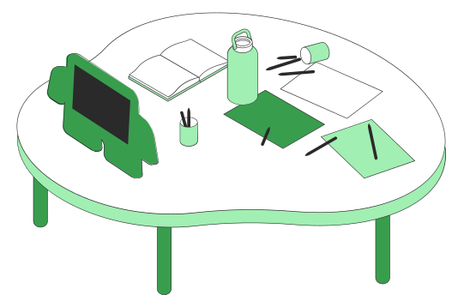
About Us.
2. Program overview.
3. Breaking down the program.
4. Achievements and restrictions.
5. Demo
Table of Contents

Slide 3

About Us.

Slide 4

Group Members
Ho Gia Huy
Nguyen Huy Hoang
Vu Tien Dung

Slide 5


2. Program Overview.
A brief overview about the program...

Slide 6

Program Structure:
Written in C++
Implements three sorting algorithms: Selection Sort, Merge Sort, and Bubble Sort
Provides functionalities for importing data, choosing algorithms, saving results, and comparing execution times.

Slide 7


3. Breaking down the program.

Slide 8


Menu Options
Users interact with the program through a menu that offers several options. You can import data from a file, choose a sorting algorithm, save sorted results to a file, and even compare the execution times of these algorithms for different input sizes.
Sorting Algorithms
Let's briefly touch upon the sorting algorithms implemented in the program:
Selection Sort: A simple and intuitive algorithm that repeatedly selects the minimum element from an unsorted part of the array and swaps it with the first element
Merge Sort: Follows a divide-and-conquer strategy. It efficiently handles large datasets by dividing them into smaller, more manageable chunks, sorting them, and then merging them back together.
Bubble Sort: A basic comparison-based sorting algorithm that repeatedly steps through the list, compares adjacent elements, and swaps them if they are in the wrong order."

Slide 9
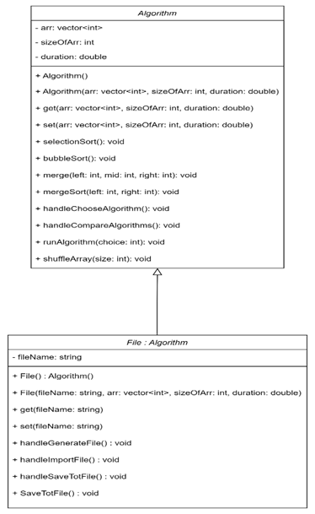
Entity Relationship Diagram
In this software, we have two class relationship:
-The first class is Algorithm with 3 fields, 2 constructors and 10 methods. The second class is File extends from class Algorithm. The File class has 1 new fields, 2 constructors and 6 methods.

Slide 10
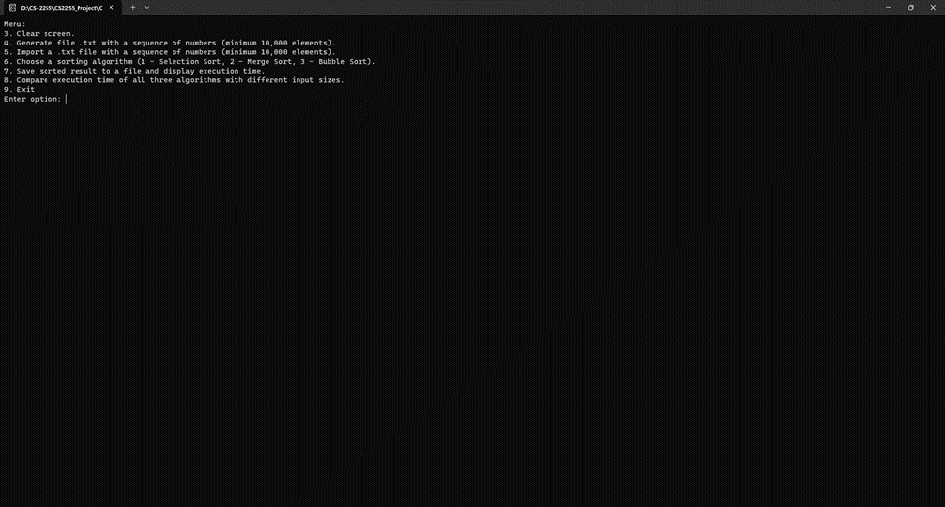
Application diagram
Program Starting

Slide 11

4. Achievements and Restrictions

Slide 12


Achievements
Modular Design: The program exhibits a modular structure with well-defined classes (Algorithm and File), promoting maintainability and code organization.
Sorting Algorithm Implementation: The program implements three common sorting algorithms (Selection Sort, Merge Sort, Bubble Sort), providing users with options to choose their preferred sorting method.
User Interaction: The menu-driven interface makes the program user-friendly, allowing users to perform various operations such as generating/importing data, choosing algorithms, executing benchmarks, and saving results.
File Operations: The program includes functionalities to generate a file with random numbers, import data from an existing file, and save sorted results to a new file.
Execution Time Measurement: Clock-based execution time measurement provides users with insights into the performance of different sorting algorithms.

Slide 13

Restrictions that need improvements
Areas for Improvement:
Input Validation: The program lacks robust input validation. It would be beneficial to include checks for invalid inputs in various user interactions to enhance the program's robustness.
Error Handling: The error handling mechanism is minimal. Incorporating more robust error handling would improve the program's resilience, especially when dealing with file operations or invalid inputs.
Memory Management: The program could benefit from more efficient memory management practices. For instance, there are instances where vectors could be cleared explicitly to manage memory better.
Reuse of Code: The Algorithm class could have more consistent use across the program. For example, the sorting algorithms could be methods of this class instead of residing in the File class.

Slide 14

Demo
We are going to run the program...

